Slide 1
My Internship Experience
By Aubrey Scott

Slide 2
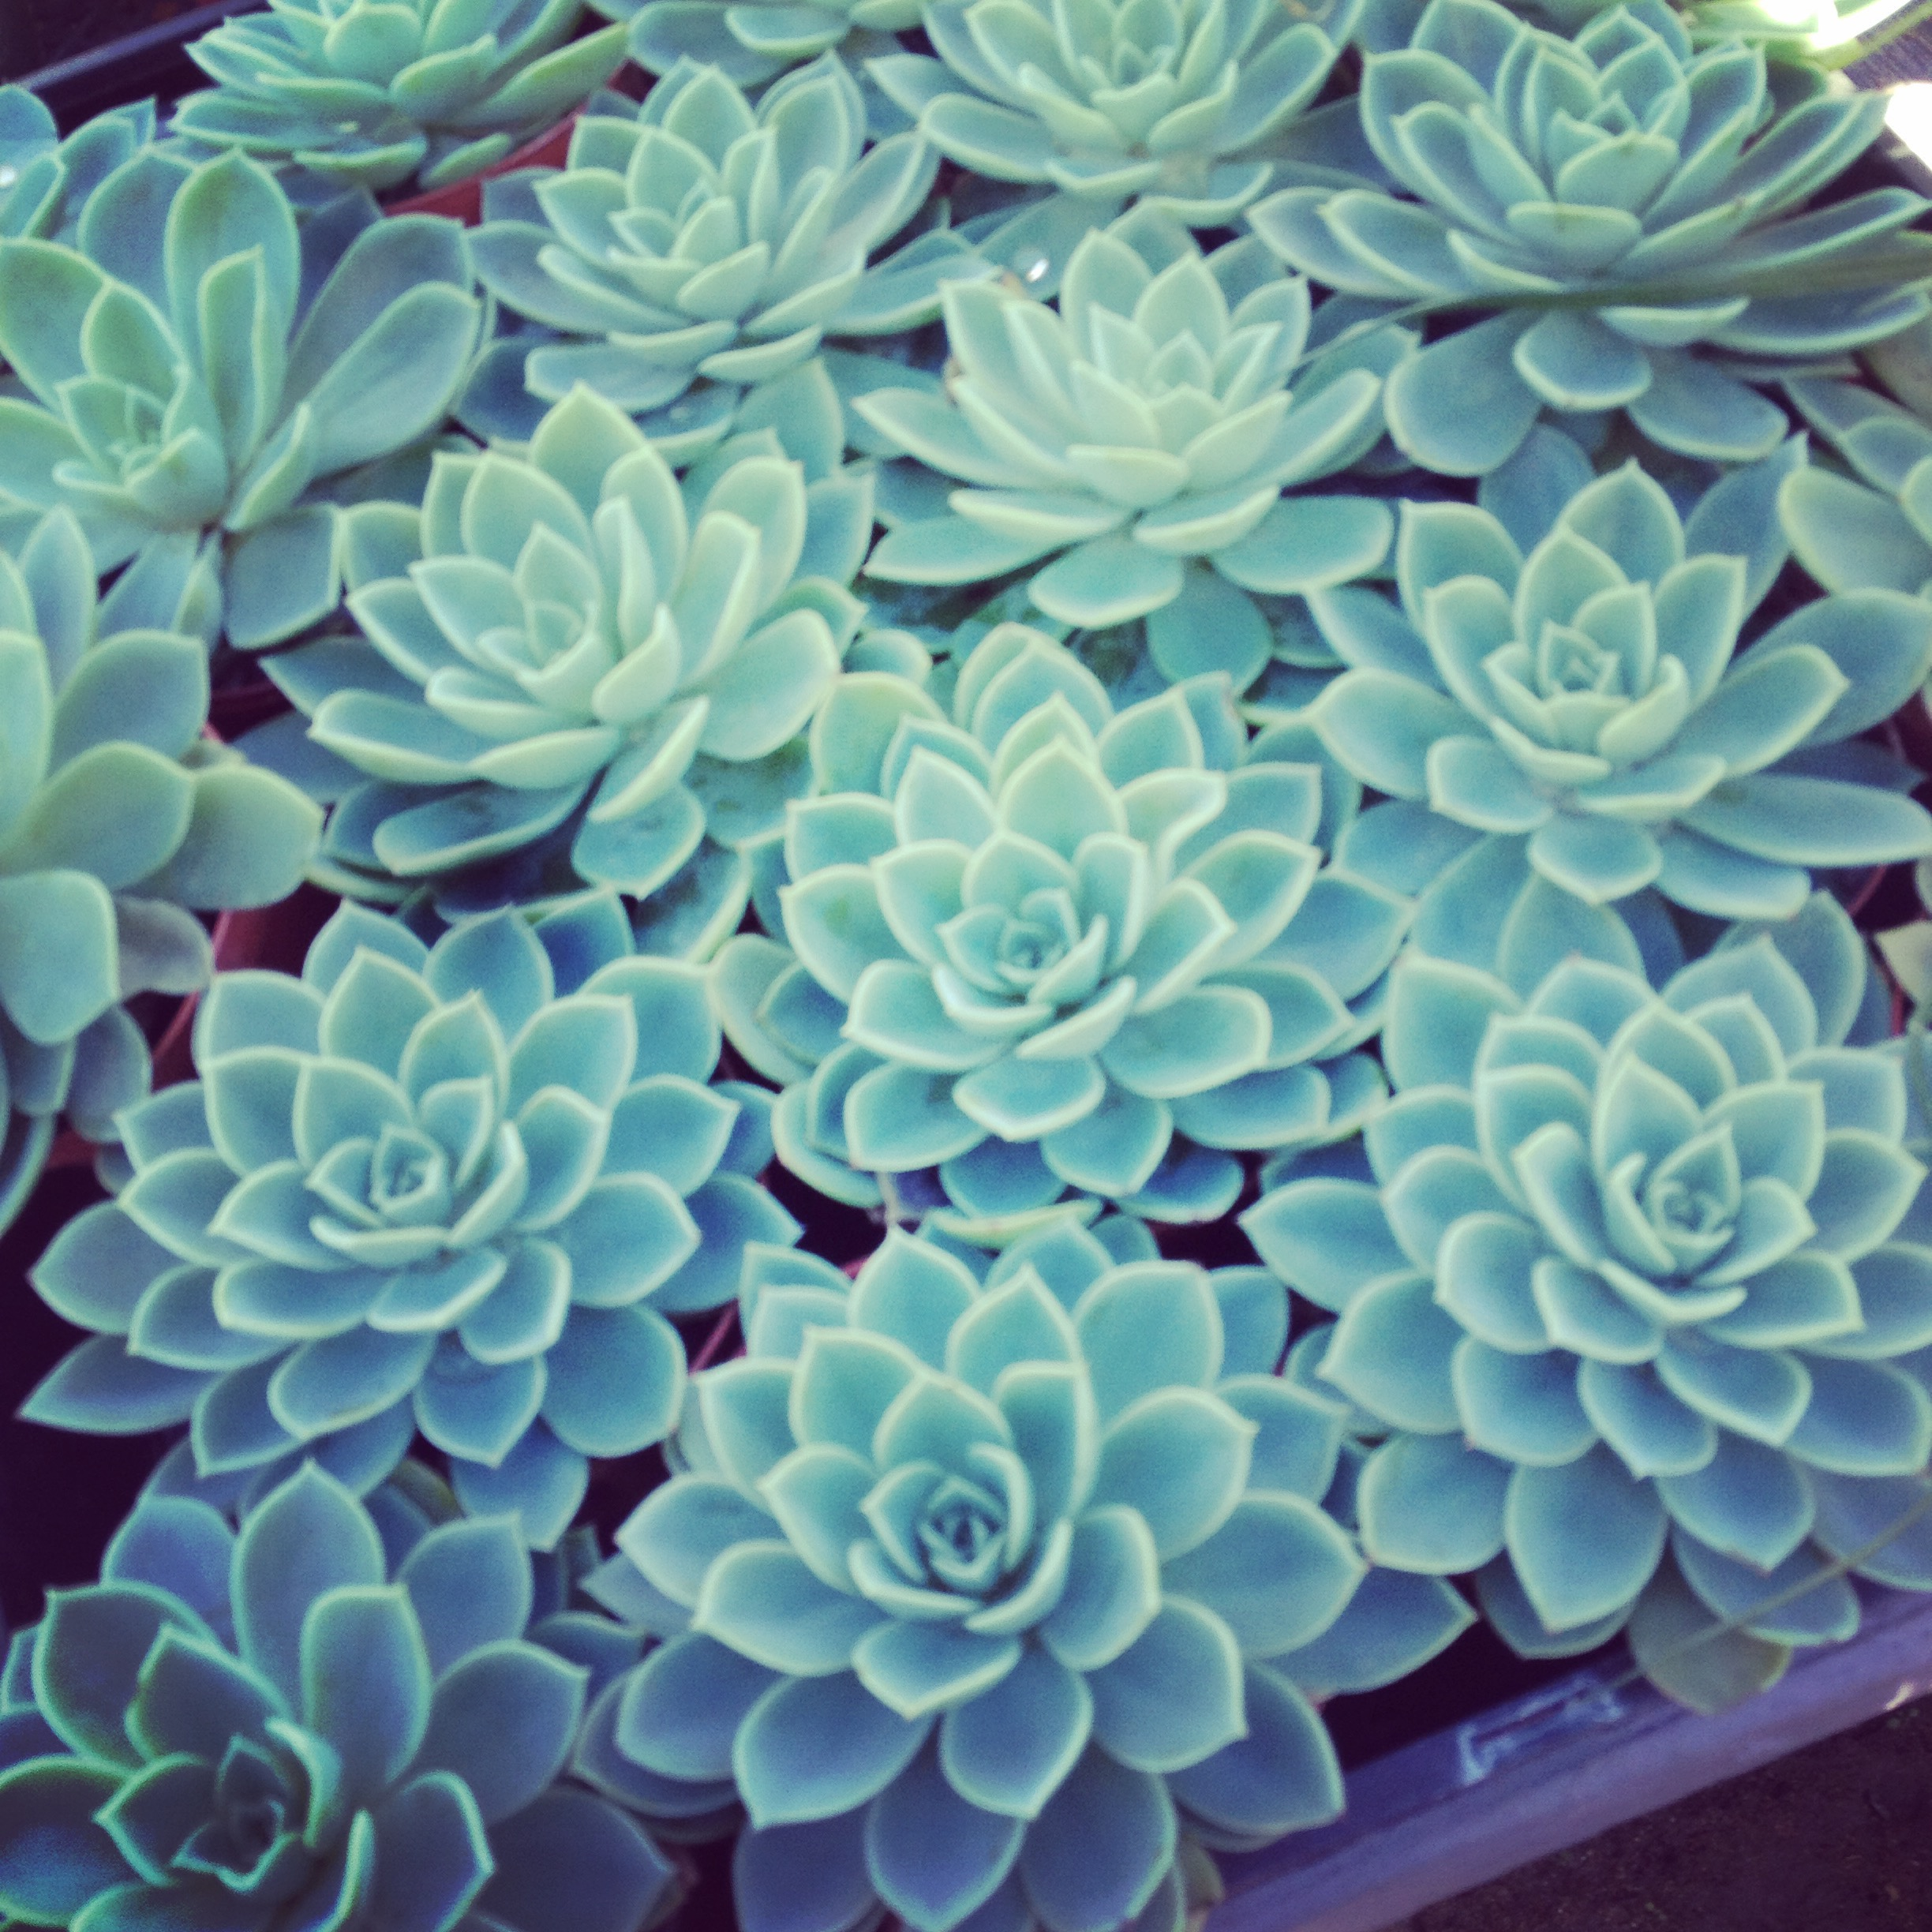
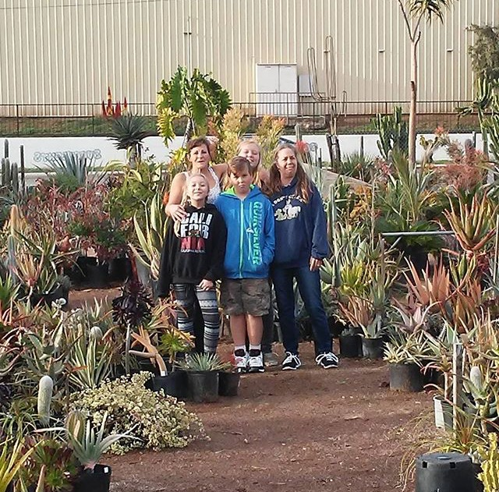
My work as an intern.

Slide 3
How did I make a meaningful contribution to my workplace?
Besides helping with my project (helping update my mentor’s website, and fixing the inventory), I helped out a lot with everyday work. My average work day ranges from re-potting plants, handling customers, making transactions, weeding, and unloading the new shipment.

Slide 4
How was my work as an intern meaningful to my education?
My internship has helped me further develop my communication skills which I can use for things in school such as presentations. It’s helped with my listening skills, because I’ve learned it’s very important to follow the instructions of your boss very carefully.

Slide 5
How was my work significant or meaningful for me beyond school and my specific internship site?
My internship has shown me what a real workplace is like, and has given me real life experience for other jobs I will have later in life. Also since I now have an internship under my belt it makes me look like a better candidate for future jobs, or a better candidate for colleges.

Slide 6
How did my project go from an idea or inspiration to a final product?
My mentor has expressed concern for his website since the beginning. He told me on how he wanted to update his website so that it had his current stock in plants, and that it would be easier for landscapers to use. It was soon clear what my project would be.

Slide 7
What did I learn about myself through working on the internship project?
I have learned that if I have money while working at a nursery I will waste all my money on new plants. On a more serious note I have learned that I am fairly decent at talking to customers, and that I didn’t have such a complete knowledge on plants that I thought I had.

Slide 8
What did I learn about the importance of (the role of) communication and self advocacy during my internship
In my internship it is extremely important to have good communication skills. We move a lot of big cacti around, and if you aren’t communicating properly someone could get hurt. Communication ensures a safe job, and it ensures a job well done.

Slide 9
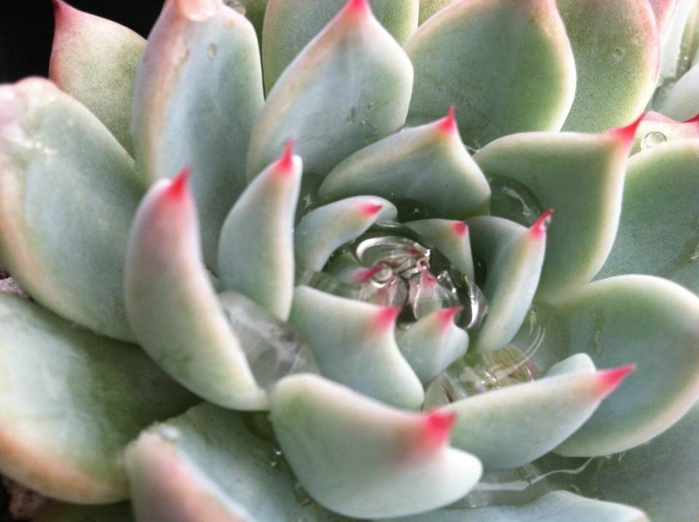
My ideas about life outside of high school

Slide 10
What new appreciations did I develop while working as an intern? Why??
I’ve learned to appreciate the everyday worker. Even if someone doesn’t have a high paying job it doesn’t mean that they don’t work hard, or even harder. My co-workers handle manual labor, customers, and teach people about plants all on a daily basis. No matter how much work they endure they end each day with a smile, and talk about how much they love their job.

Slide 11
What qualities or characteristics did I see in the people around me that I want to develop in myself? Why?
When I first met my mentor he told me on how he would rather sell someone a plant that he know would live in their area, and teach them how to care for that plant rather than selling as many plants as he can. That aspect of being an honest businessman really struck me in a good way, and It let me know what kind of a person my mentor was. That is a quality I want in myself.

Slide 12
How did my view of life beyond high school change or develop during my time as an intern?
I got to see that my life will change after high school, and how things are now will not be the same once I graduate.

Slide 13
How might internship influence the direction of my life
While I do love plants I wasn’t exactly sure that I want to continue a career with them. I have many other ideas for future careers, and I was hoping that my internship would give me some insight on that. Although I am still not sure, It will help narrow down the choice since I have seen what a career dealing with plants is like.

Slide 14
How did communication and/or collaboration at work influence my understanding of professional working environments?
I’ve learned in a work environment that communication is key for any successful business. If the communication between an employer and his employees fails, then the business fails alongside it. I hope that I can take this lesson I learned, and that I can use it towards school/future jobs.

Slide 15
My Project

Slide 16
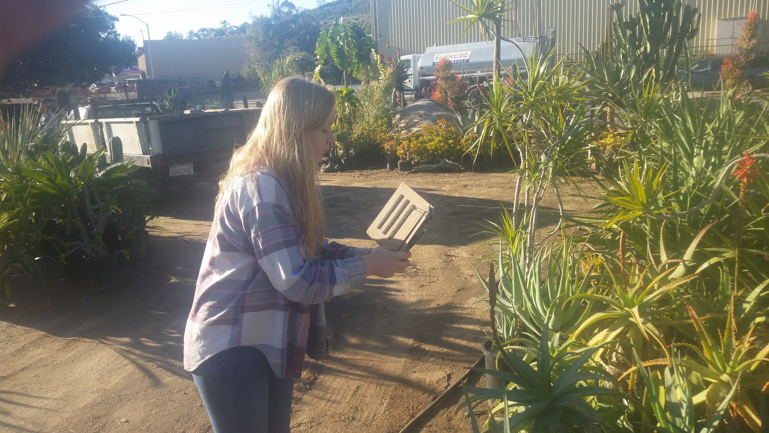
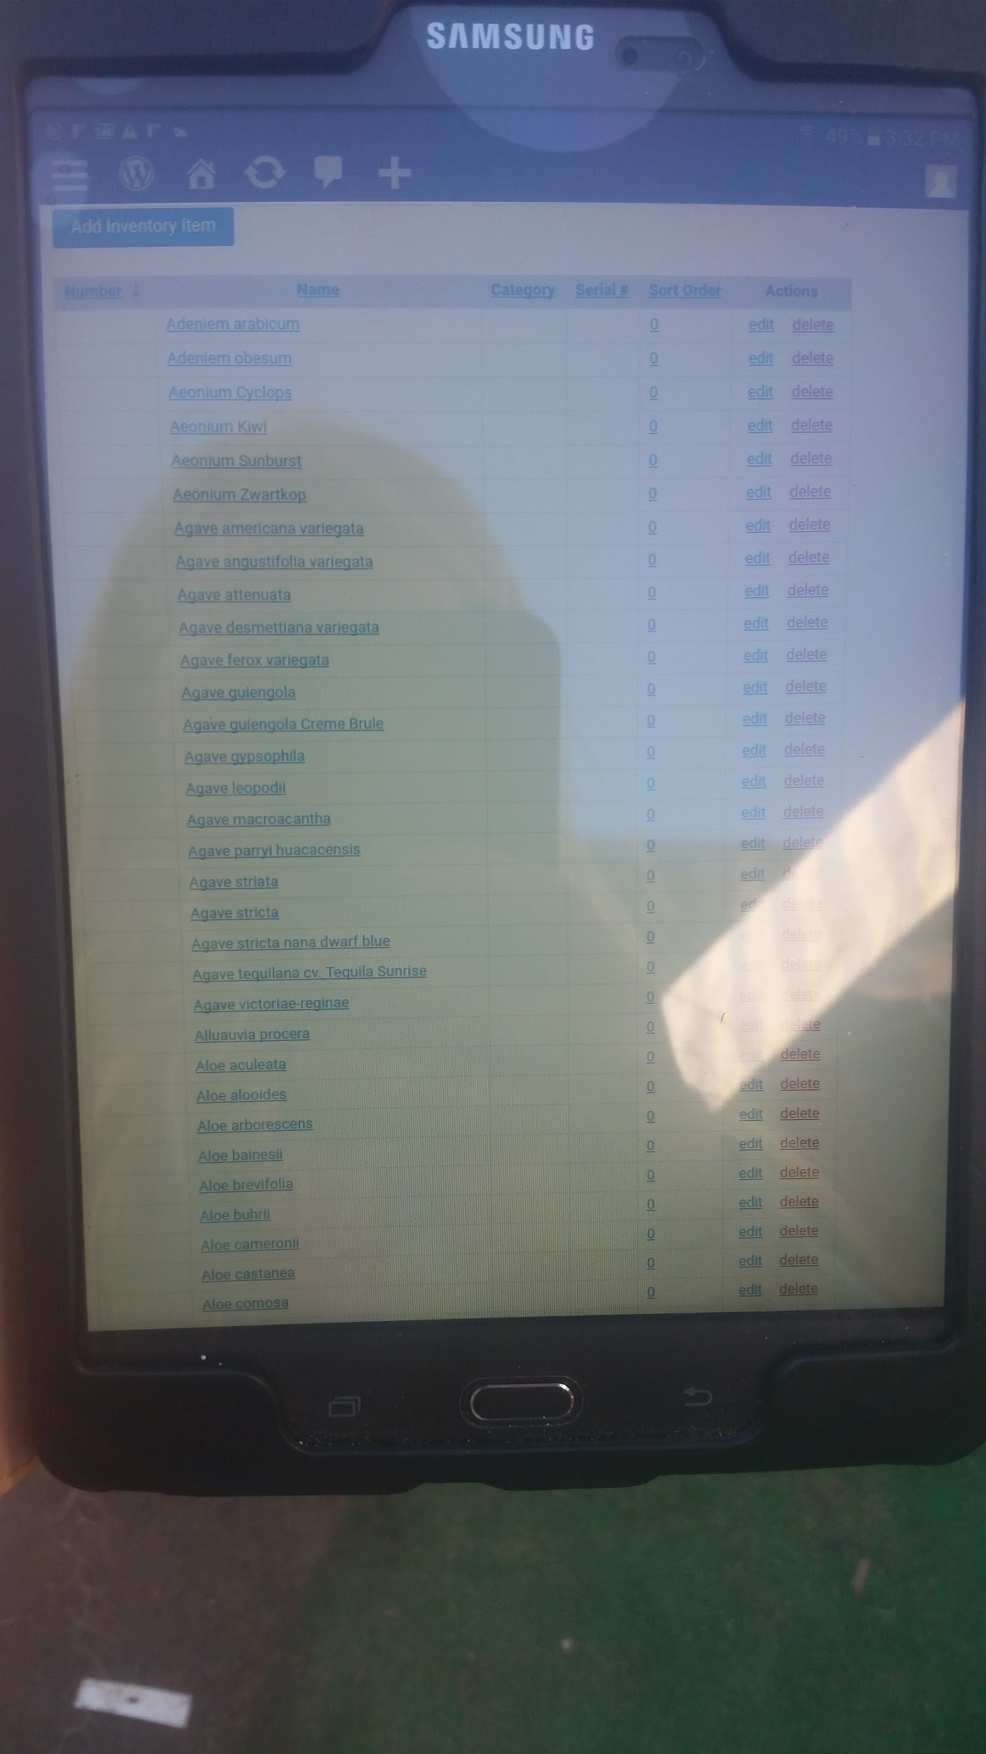
For my project my mentor requested that I assist him in updating his online plant inventory. He had expressed concern on how old it was, and how he wanted it to be easier for landscapers to use. So my mentor and I got together, and we started to fill out his list. This meant that we had to place all the names of the plants in on his tablet, and go out to take all the pictures we needed.
Here I am taking pictures of the plants for my project.
This is the tablet that I was updating the list on. What’s on the screen is the first page of the list

Slide 17
Q & A

